Slide 1
University of Diyala
College of Engineering
Department of Architecture
1ST Stage
2018 – 2019
Lecture_ 03

Slide 2
From Line to Plane
Two parallel lines have the ability to visually describe a plane. A transparent spatial membrane can be stretched between them to acknowledge their visual relationship. The closer these lines are to each other, the stronger will be the sense of plane they convey.

Slide 3
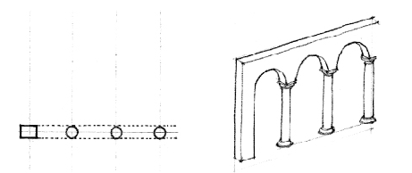
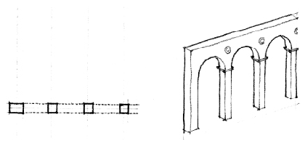
The diagrams illustrate the transformation of a row of round columns, initially supporting a portion of a wall, then evolving into square piers which are an integral part of the wall plane, and finally becoming pilasters—remnants of the original columns occurring as a relief along the surface of the wall.

Slide 4
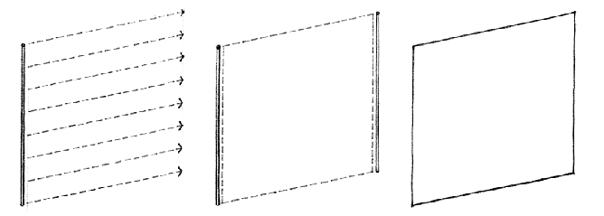
PLANE:
Aline extended in a direction other than its intrinsic direction becomes a plane. Conceptually, a plane has length and width, but no depth.
PLANE:
A line extended in a direction other than its intrinsic direction becomes a plane. Conceptually, a plane has length and width, but no depth
Shape is the primary identifying characteristic of a plane. It is determined by the contour of the line forming the edges of a plane. Because our perception of shape can be distorted by perspective foreshortening, we see the true shape of a plane only when we view it frontally.
The supplementary properties of a plane—its surface color, pattern, and texture—affect its visual weight and stability.

Slide 5
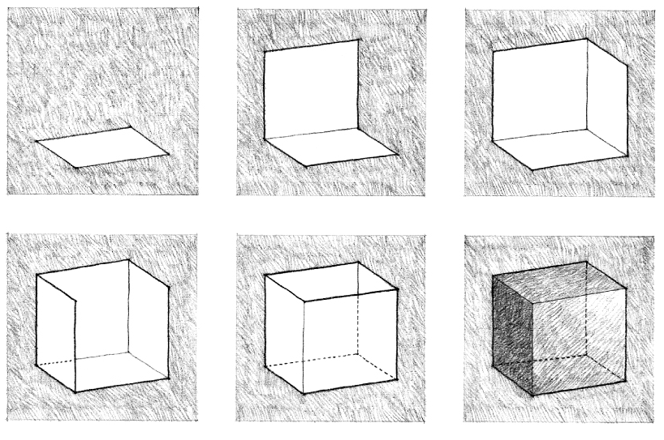
In the composition of a visual construction, a plane serves to define the limits or boundaries of a volume. If architecture as a visual art deals specifically with the formation of three-dimensional volumes of mass and space, then the plane should be regarded as a key element in the vocabulary of architectural design.

Slide 6
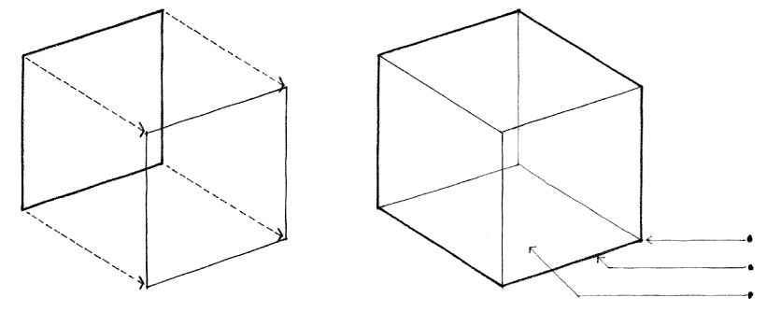
VOLUME:
A plane extended in a direction other than its intrinsic direction becomes a volume. Conceptually, a volume has three dimensions: length, width, and depth. All volumes can be analyzed and understood to consist of:
points or vertices where several planes come together.
lines or edges where two planes meet.
planes or surfaces that define the limits or boundaries of a volume.

Slide 7
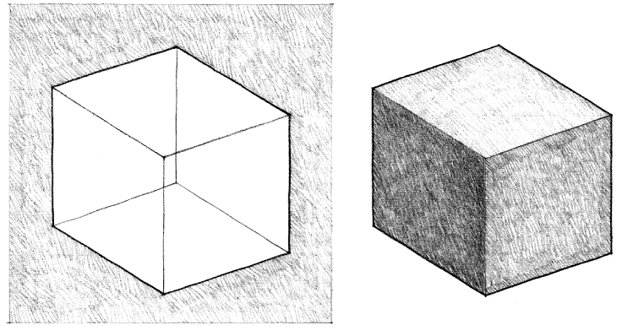
As the three-dimensional element in the vocabulary of architectural design, a volume can be either a solid—space displaced by mass—or a void—space contained or enclosed by planes.

Slide 8
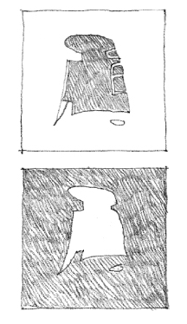
In architecture, a volume can be seen to be either a portion of space contained and defined by wall, floor, and ceiling or roof planes, or a quantity of space displaced by the mass of a building. It is important to perceive this duality, especially when reading orthographic plans, elevations, and sections

Slide 9
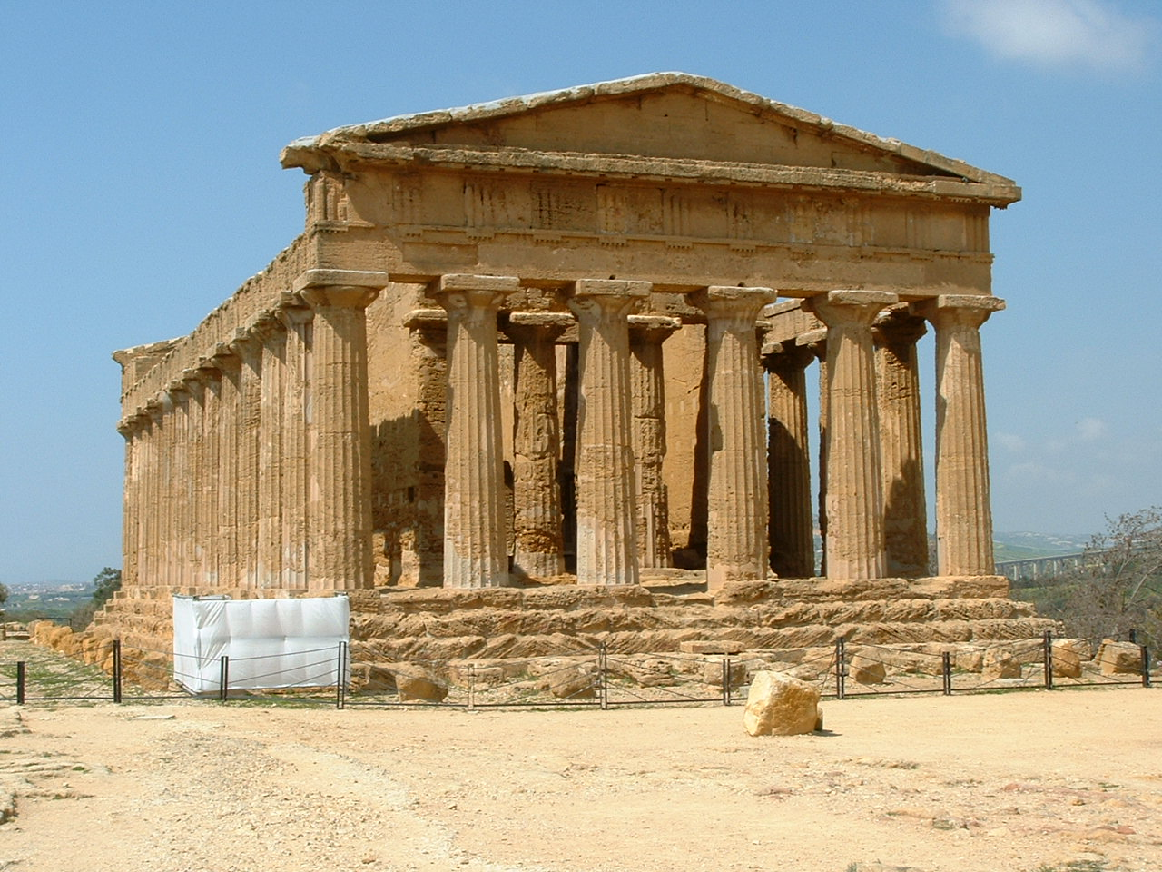
VOLUMETRIC ELEMENTS: Building forms that stand as objects in the landscape can be read as occupying volumes in space.

Slide 10
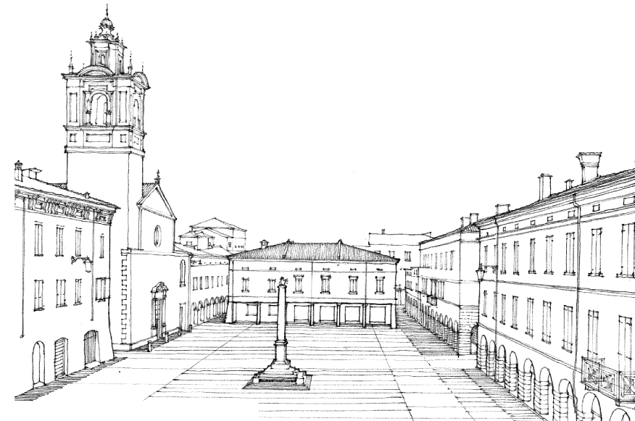

Slide 11
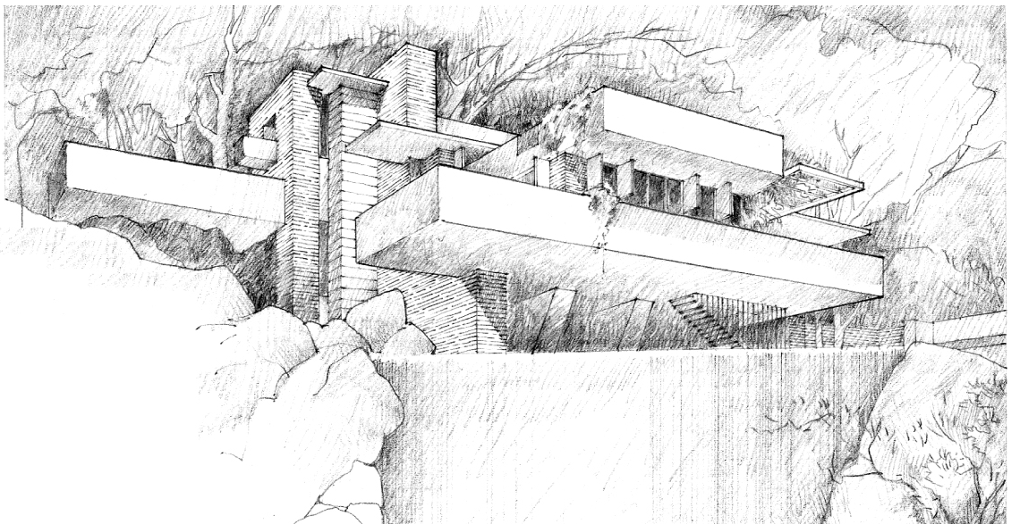

Slide 12
